Slide 2
Presenter Introduction:
Heidi Sinkovic
Director of Exceptional Student Services
Entering my 10th year at The Leona Group
Art/English/Humanities Teacher and Special Education Coordinator at Sun Valley High School prior to current position
BA and MA in Art History, Arizona State University
Post Baccalaureate Teacher Preparation Secondary Education, Rio Salado College
HQ Areas/Certification:
Special Education k-12: Cross-Categorical, Secondary English, German (HQ), Art (HQ)
Mentor of 4 Special Education Directors through ADE Mentorship Program
Member of Superintendent Huppenthal’s Special Education Advisory Group
Selection and Planning Committee Member for TLG Aspiring School Leaders Program
Member of ADE Special Education Rule Change Core Committee
Member of ADE Special Education Certification Change Group (12/13)
Founded Charter School Special Education Director’s Group with Udall Shumway

Slide 3
This Session’s Goals:
Identify the challenges of implementing CCRS for SWD
Identify barriers to access of CCRS and brainstorm strategies to eliminate barriers
Understand accommodations and modifications
Understand differentiated grading and instruction while maintaining rigor
Utilize the Leona Group Lesson Plan Template with sample scenarios
Develop plans to integrate special education, RtI and general curriculum instruction and assessment

Slide 4
Research Based Support for Today’s Session:
Council for Exceptional Children. Universal Design For Learning: A Guide for Teachers and Education Professionals. Pearson, 2005.
Wormeli, Rick. Fair Isn’t Always Equal: Assessing & Grading in the Differentiated Classroom. Stenhouse Publishers, 2006.
IDEA 2004: http://idea.ed.gov/explore/home
http://www.ascd.org/publications/educational-leadership/feb10/vol67/num05/Grading-Exceptional-Learners.aspx
http://www.naesp.org/sites/default/files/McLaughlin_2012.pdf
http://www.cde.ca.gov/SP/se/cc/
http://www.cast.org/udl/

Slide 5
So, what about students with disabilities?
What Do You Believe about SWD?
What Is Required?
Sec. 300.320 Definition of individualized education program.
(a) General. As used in this part, the term individualized education program or IEP means a written statement for each child with a disability that is developed, reviewed, and revised in a meeting in accordance with Sec. Sec. 300.320 through 300.324, and that must include--
(1) A statement of the child's present levels of academic achievement and functional performance, including--
(i) How the child's disability affects the child's involvement and progress in the general education curriculum (i.e., the same curriculum as for nondisabled children);
----------------
(2)(i) A statement of measurable annual goals, including academic and functional goals designed to--
(A) Meet the child's needs that result from the child's disability to enable the child to be involved in and make progress in the general education curriculum; and
(B) Meet each of the child's other educational needs that result from the child's disability;
---------
(4) A statement of the special education and related services and supplementary aids and services, based on peer-reviewed research to the extent practicable, to be provided to the child, or on behalf of the child, and a statement of the program modifications or supports for school personnel that will be provided to enable the child--
(i) To advance appropriately toward attaining the annual goals;
(ii) To be involved in and make progress in the general education curriculum in accordance with paragraph (a)(1) of this section, and to participate in extracurricular and other nonacademic activities; and
(iii) To be educated and participate with other children with disabilities and nondisabled children in the activities described in this section;
(5) An explanation of the extent, if any, to which the child will not participate with nondisabled children in the regular class and in the activities described in paragraph (a)(4) of this section;
Notes:
Ask them—what do you believe??

Slide 6
So, what about students with disabilities?
What We Believe about SWD:
All students can learn regardless of their background.
Students with disabilities are best served in the regular classroom or least restrictive environment with an effective teacher and rigorous curriculum.
Students with disabilities can and will succeed.
Notes:
Big Picture context TLG message

Slide 7
So, what about students with disabilities?
“Special education is specially designed instruction, at no cost to the parents, to meet the unique needs of a child with a disability.”
“Special Education” is not a place, but instruction and supports to meet a student’s needs—it can be delivered across a wide range of settings
Specially designed instruction means adapting, as appropriate to the needs of an eligible child under this part, the content, methodology, or delivery of instruction—
(i) To address the unique needs of the child that result from the child’s disability; and
(ii) To ensure access of the child to the general curriculum, so that the child can meet the educational standards within the jurisdiction of the public agency that apply to all children. [§300.39(b)(3)]
Notes:
Big Picture context TLG message

Slide 8
Accommodations and Modifications
Accommodations:
An accommodation is a change that helps a student overcome or work around the disability.
Accommodations generally apply across classes/environments at school.
Modifications:
A modification means a change in what is being taught to or expected from the student.
Modifications can be made to:
what a child is taught, and/or
how a child works at school.
Notes:
Examples?? Have them share out one of each?

Slide 9
Universal Design for Learning
http://www.udlcenter.org/resource_library/videos/udlcenter/udl#video0

Slide 10
Universal Design for Learning

Slide 11
UDL and Lesson Plans
Look at the UDL Framework and your Lesson Plan
Look at the TLG Lesson Plan Template
Think about and be prepared to share:
Does your current lesson plan incorporate UDL at the planning stage?
If yes, how? If no, how could you incorporate it?
Does the TLG Template include UDL? How? Why?

Slide 12
Workshop
In your Group:
Review the IEP information sheets/504 plan for each student and think about the following questions
what can the student do?
what does the student struggle with?
what does the student need?
what should you be doing for this student no matter what?
Summarize and come to a consensus as group
Notes:
Review IEP Information Sheets for each student
Summarize the students within your group and come to a consensus about what students need accom/mod
(slide 1) after this 1 slide / student with accom/mod charts for each kid→have them report out the findings

Slide 13
Leonardo DaVinci
Accommodations | Modifications | Instruction, Supports

Slide 14
Mary Contrary
Accommodations | Modifications | Instruction, Supports

Slide 15
Sandro Botticelli
Accommodations | Modifications | Instruction, Supports

Slide 16
Venus DeMilo
Accommodations | Modifications | Instruction, Supports

Slide 17
Workshop
In your Group:
Using the 4 IEPs go through your lesson plan. Evaluate the plan and how it addresses student needs based on IEP information.
Think about:
What barriers are preventing the student from demonstrating mastery accurately, if any?
How would you modify the activity/assessment for each student, if at all?
Would you use a different activity/assessment to measure mastery for this student? Why/why not?
Discuss and record what you would do with each assessment based on the student information.

Slide 18
Leonardo DaVinci
Accommodations | Modifications | Alternate Activity/Assessment

Slide 19
Mary Contrary
Accommodations | Modifications | Alternate Activity/Assessment

Slide 20
Sandro Botticelli
Accommodations | Modifications | Alternate Activity/Assessment

Slide 21
Venus DeMilo
Accommodations | Modifications | Alternate Activity/Assessment

Slide 22
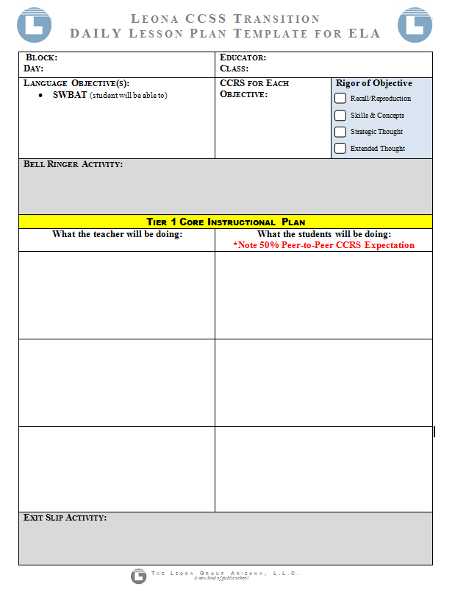
TLG Lesson Plan

Slide 23
Grading Questions…
Can a SWD earn an A?
Can a SWD earn an F?

Slide 24
Grading Questions…
How can I give them credit when my SWD has not done the same work as the rest of the class?

Slide 25
Grading Questions…
If she’s reading at the 5th grade level why am I giving her my 10th grade reading assignments?

Slide 26
Grading Questions…
How can I justify passing him if he doesn’t complete my final project (senior project huge portfolio)? All of it is a necessary component toward grad requirements.

Slide 27
Grading Questions…
Rate the quality of this teacher’s application of accom / mod : At the end of the block, I just go through Gradebook and make adjustments to assignments based on each student’s IEP.

Slide 28
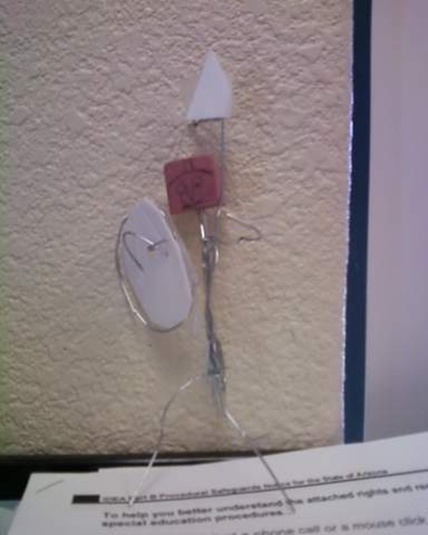
Grading Questions…
I have an incredibly auditory student who is classified ED. In history class, I asked students to write a report on Spartans. This student refused to write and refused to give an oral presentation. I found paperclips and other materials and told the student to make a Spartan.

Slide 29
Thank You!!!
A session survey will be emailed to you this week through a Googledoc. Kindly complete it so we can reflect and improve future PD efforts.
Travel safely!

